Slide 1
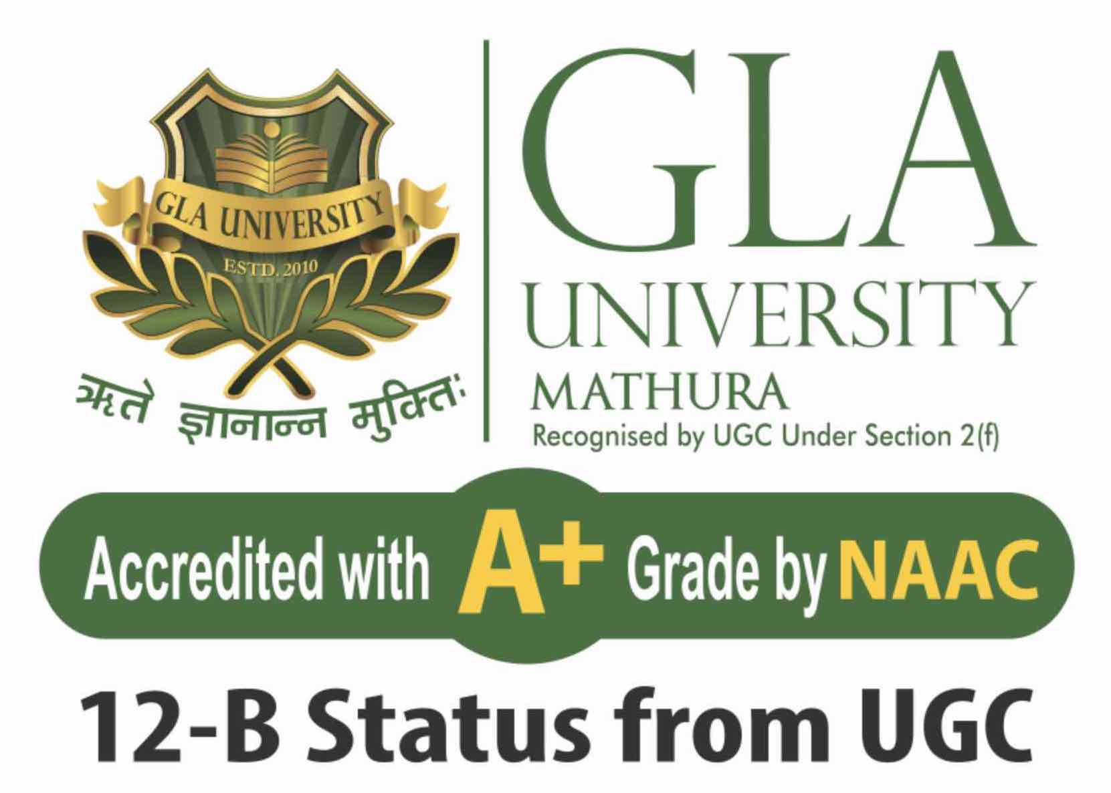
GLA UNIVERSITY MATHUTA
WASTE MANAGEMENT SYSTEM
Name- Abhist Pratap Singh,Yugul Pratap Singh, Rameshwar Singh, sakshi Singh
Course- B.tech Cse
Date- 30/11/2023

Slide 2
INTRODUCTION
Welcome to the Waste Management System, where innovation meets sustainability.
In this initiative, we aim to transform traditional waste management practices through the development of a robust and user-friendly web application.
Our goal is to optimize waste tracking, real-time bin monitoring, and route planning, while also providing comprehensive reporting, analytics, and compliance features.
Join us in creating a smarter, more sustainable future for waste management.

Slide 3
Problem Statement or the Motivation
Problem Statement:
Inefficient Waste Management Practices
Lack of Real-Time Monitoring
Data Fragmentation
Motivation:
Environmental Impact
Operational Optimization
Data-Driven Solutions
Compliance and Regulation

Slide 4
OVERVIEW
The Waste Management System is a comprehensive solution that not only addresses current waste management challenges but sets the stage for a more sustainable and efficient future.
Expect a user-friendly platform with real-time monitoring, data-driven insights, and tools to streamline operations, all while ensuring compliance and scalability for evolving waste management needs.

Slide 5
OBJECTIVE
Systematic Waste Tracking
Real-Time Bin Monitoring
Route Optimization Algorithms:
Reporting and Analytics Tools:
Automated Notifications:
Mobile Responsiveness:
Administrative Dashboard:
Through the Waste Management System project, our aim is to revolutionize waste management practices by achieving operational efficiency, promoting environmental sustainability, fostering data-driven decision-making, ensuring compliance, and ultimately delivering a user-friendly solution that addresses the diverse needs of waste management stakeholders.

Slide 6
Problem Statement
Define the Problem:
Traditional waste management relies heavily on manual processes, leading to inefficiencies in tracking, collection, and disposal.
Absence of real-time monitoring results in suboptimal waste collection routes, leading to increased costs and resource consumption
Disparate data sources and manual record-keeping contribute to data fragmentation, hindering effective decision-making and planning.
Why is it Important or Relevant?
Environmental Impact
Operational Costs:
Regulatory Compliance:
Public Health and Safety:
Data-Driven Decision-Making:

Slide 7
Literature Review
Related Work:
Traditional Waste Management Systems
GIS-Based Solutions(Geographical Information System)
Mobile Applications:
IoT-Driven Waste Solutions:
Gap Your Project is Filling:
Integrated Solution
Real-Time Monitoring with Scalability:
User-Friendly Administrative Interface:
Comprehensive Data Analytics:

Slide 8
Methodology
Algorithms and Techniques:
Route Optimization
Real-Time Monitoring
User Authentication
Data Analytics
Tools and Languages:
Frontend Development
Backend Development
Database Management
Mapping and GIS Integration
Security Measures
Data Visualization

Slide 9
System Archietecture
Components:
User Interface (UI):
Backend Server:
Database:
Authentication Module:
Real-Time Monitoring Module:
Route Optimization Module:
Reporting and Analytics Module:
Reporting and Analytics Module:
GIS Integration:

Slide 10
Interaction:
User Interaction
Server-Client Interaction:
Real-Time Monitoring Integration:
Data Analytics Flow:
Notification Triggers:

Slide 11
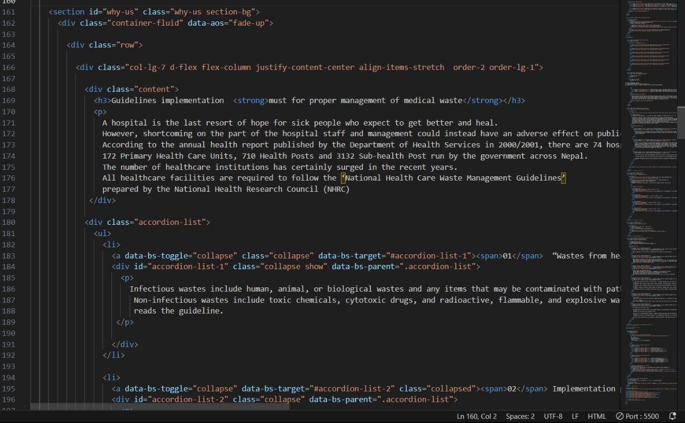
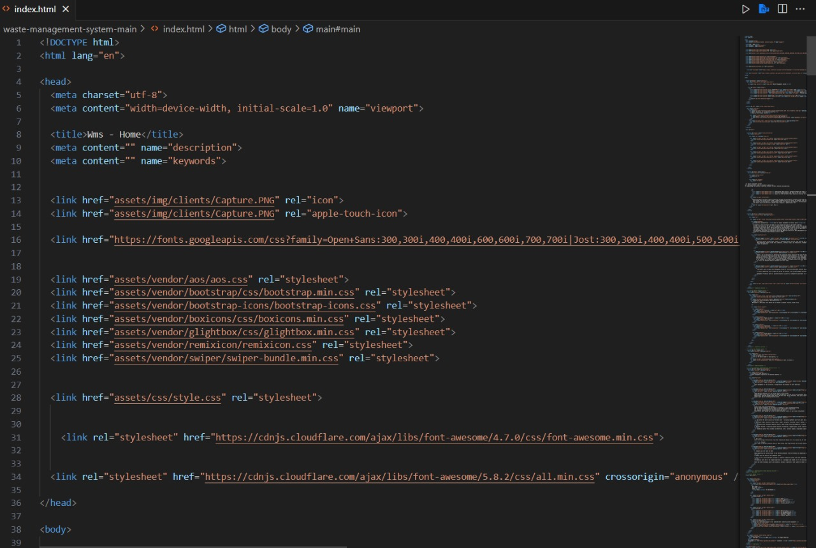
Implementation

Slide 12
FEATURES
Key Features of Waste Management System
Waste Tracking
Real-Time Monitoring
Route Optimization
Reporting and Analytics
Automated Notifications
User Authentication
Administrative Dashboard
Mobile Responsiveness
Compliance Features

Slide 13
Unique Functionalities:
Real-Time Route Adjustments
Predictive Analytics
IoT Integration

Slide 14

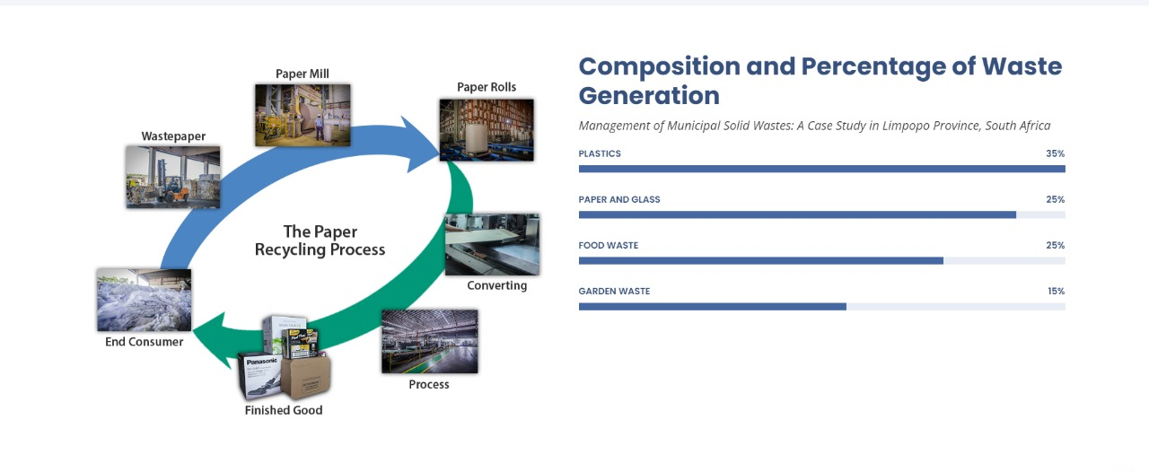




RESULTS

Slide 15
Challenges Faced
Challenges Encountered:
Real-Time Integration
Data Security Concerns
Algorithm Complexity
User Interface Design
Solutions Implemented:
Real-Time Integration
Data Security Concerns
Algorithm Complexity
User Interface Design

Slide 16
FUTURE WORK
Future Improvements and Extensions
Enhanced IoT Integration
Machine Learning for Predictive Analytics
Mobile Application Development
Smart Bin Technology
Automated Data Entry
Continuous Security Measures
Additional Features and Functionalities
Smart Bin Inventory Management:
Weather Integration:
Carbon Footprint Calculator
Social Collaboration Platform:
Waste Source Tracking:
Waste Source Tracking:

Slide 17
Conclusion
In conclusion, the Waste Management System (WMS) has successfully transformed waste management into a user-friendly and transparent process. By providing an easy way for citizens to report concerns and track the progress of their complaints, WMS bridges the gap between communities and municipalities.
Additionally, WMS serves as an educational platform, offering valuable insights into responsible waste practices. As we celebrate one year of WMS, we remain committed to creating a greener and cleaner future. Thank you for being part of our community and contributing to sustainable waste management.

Slide 18
Acknowledgments and Appreciation
Professors and Mentors:
Thank you to our esteemed professors and mentors for their guidance, encouragement, and invaluable insights that shaped the development of the Waste Management System.
Team Collaboration:
A heartfelt appreciation to every team member who contributed their skills, dedication, and collaborative spirit to make this project a success.
Peers and Colleagues:
Thank you to our peers and colleagues for their support, constructive feedback, and camaraderie throughout the development process.

Slide 19
Q&A
Open the floor for questions from the audience

